Slide 1
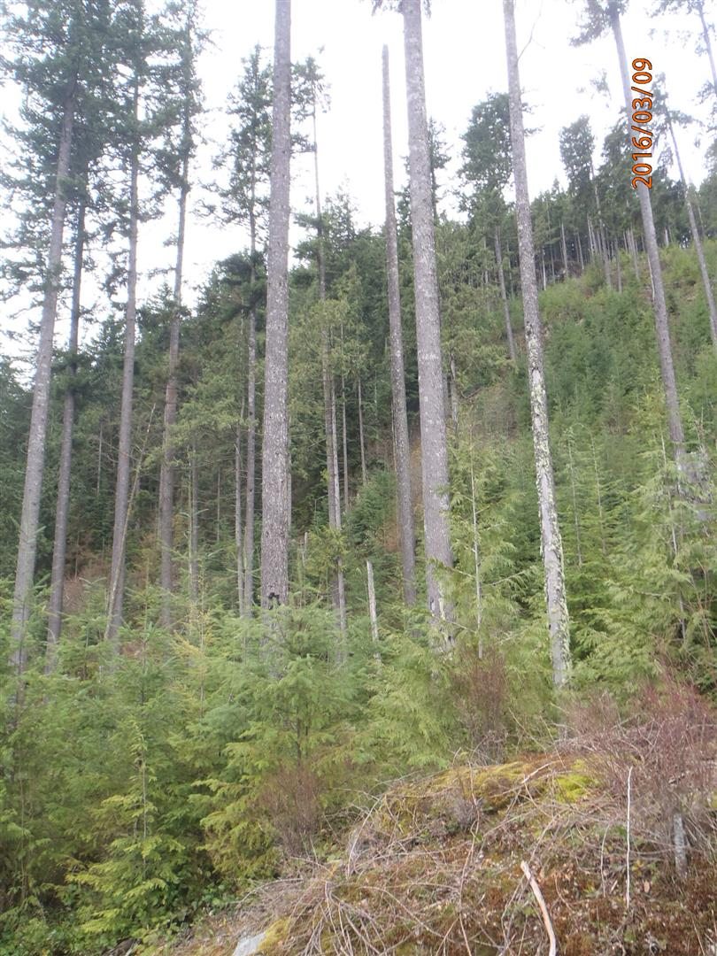

Single Entry Dispersed Retention Stocking Standard (SEDRSS) Framework for
Coastal second Growth Douglas –fir
October 28, 2016
Coast Region FRPA Implementation Team
Notes:
Introduction
Craig Wickland, Chair CRIT silviculture working Group
The Single entry dispersed retention stocking standard framework was jointly developed by the CRIT silviculture working group (Industry and Government representatives) and agency resource specialists from FLNRO (e.g., silviculture surveys specialist). The paper was endorsed by CRIT in late 2009.
In 2013 the SEDRSS standard was calibrated for old growth hemlock-cedar types. This SEDRSS standard for old Hw/Cw has been adopted in many coastal FSPs.
In 2015-16 the SEDRSS standard was calibrated for second growth Douglas-fir type in recognition of the need to for a tool to manage for non-timber resource values (e.g., visual quality objectives, wildlife values e.g., spotted owls) in these stand types. This has been published as Appendix 3 to the SEDRSS framework

Slide 2
Coast Region FRPA Implementation Team
Background
Framework is designed to address stand level sustainability issues often associated with partial cut practices
Framework is intended to replace the Single Tree Selection multi-layered stocking standards
Framework is designed to create a suitable regeneration environment without additional harvest entries as well as maintain some stand value for future harvest.
Notes:
Until recently partially cutting on the coast was described under the umbrella of a single tree selection silvicultural system, often incorrectly since this type of silvicultural system assumes multiple harvest entries.
Most of the partial harvest on the coast has been single entry to meet a resource value objective or constraint that often requires long term retention.
The most commonly applied stocking standards to partial harvest stands has historically been the multi-layered stocking standards associated with a single tree selection silvicultural system. The other approach has been even-aged stocking standards with the retention being ignored for stocking purposes. Neither of these approaches fit well since they do not capture that interactions between overstory and understory trees, especially when overstory trees are retained for long periods of time.
Until the now SEDRSS was only calibrated for old growth Cw/Hw stands and was not appropriate for second growth Fd or Fd/Hw stands

Slide 3
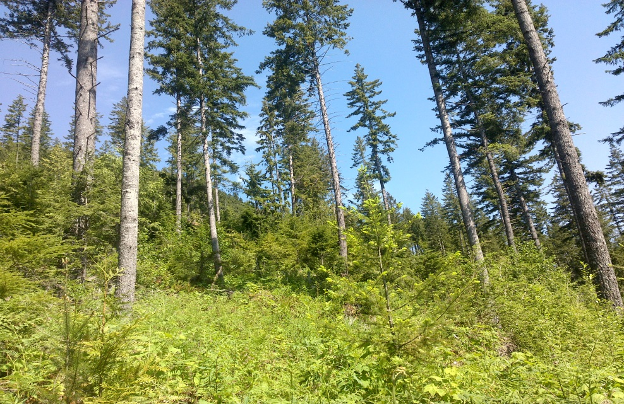
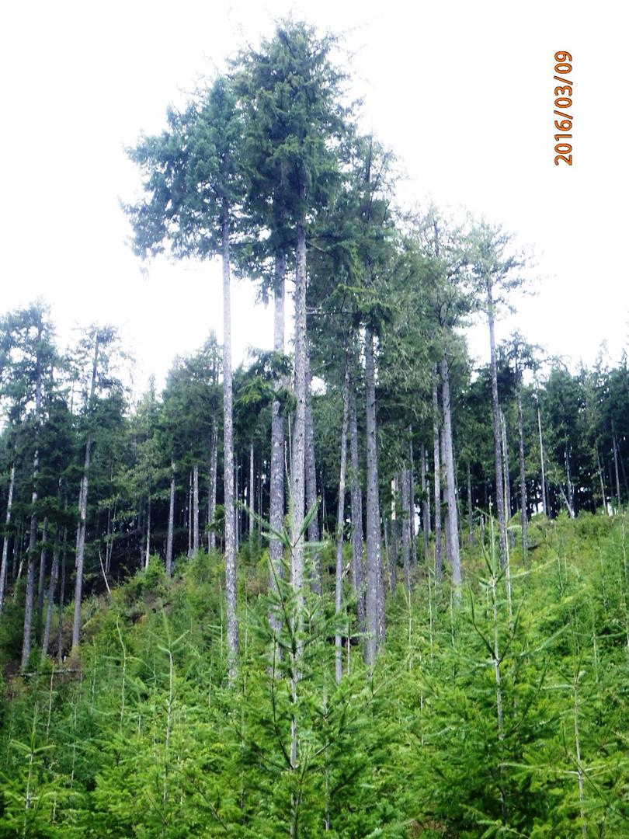
Coast Region FRPA Implementation Team
What is the single entry dispersed retention stocking standard?
A standard to be applied in stands where overstorey trees contribute to the stocking obligation but no future harvest entries are required to meet stand structural objectives
Notes:
The stocking standard is the timber linkage between the stand level and forest level management activities.
The FSP defines the scope and scale (situations or circumstances) as to where a stocking standard will be applied.
The standard establishes the reference point from which growth and development of a managed stand can be predicted and modeled.
When the scope and scale of application and growth and development modeling are combined the practice can be incorporated into the timber supply review process.

Slide 4
SEDRSS - Fdc
Stocking standard Principles
Be based on ecologically suitable species
Be measureable
Describe where and when it will apply (situations or circumstances)
Have clearly defined target conditions
Have a specified time element for achievement
Maintain or improve forest health (leave tree criteria)
Maintain or minimize the impacts to stand productivity
Maintain or enhance the commercially valuable timber supply
Be flexible
Coast Region FRPA Implementation Team
Notes:
The standard also needs to define acceptable levels of variability and have a reasonable chance of achieving the target stand structural conditions
Relative shade tolerance of regenerating species is a key component when developing SEDRSS standards for second growth Fdc

Slide 5
SEDRSS Application - Fdc
This stocking standard framework is not meant for:
Clearcuts or stands with low levels of dispersed retention.
For areas with ≤ 4 m2/ha dispersed RBA an even aged stocking standard is appropriate.
Stands with no regeneration objective
For stands with ≥ 40m2/ha dispersed RBA, a standard based on RBA only with no regeneration component is appropriate.
The SEDRSS Fdc standard is calibrated for:
Second growth Fdc or Fdc/Hw mixes (> 80 % second growth) where the site index for Fdc is between 24 and 36
CDF and CWH subzones in maritime and submaritime areas
Coast Region FRPA Implementation Team
Notes:
Stands with no regeneration objectives are most often stands subject to intermediate cutting .. Leaving a fully stocked stand
It is not appropriate for other subzones within the CWH where Fd may grow. For IDF transition zones it is recommended to use interior DFP tables
It is important to note that shade tolerance of Fdc decreases with more northerly latitudes and increased precipitation. Fdc is a light demanding species and demonstrates lower growth rates underneath retained trees.
While Fdc is somewhat shade tolerant in the drier CDF it is very shade intolerant in the wetter CWH vm1/2
Research has shown that growth losses for Fdc increase rapidly where dispersed retention exceeds 4-6 m2 per ha

Slide 6
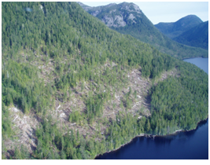
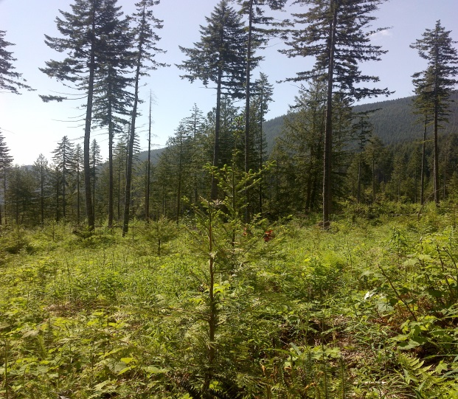
SEDRSS Application Fdc
Low retention ( < 4 m2 per ha)
The landscape is not constrained by
non timber resource objectives
SEDRSS does not apply
Even –aged standards apply
Fdc primary species for regeneration
Moderate retention (4 to 10 m2 per ha)
Resource values moderately constrain
post harvest stand structure
SEDRSS applies
Fd primary species for regeneration
(ecologically suitable)
Coast Region FRPA Implementation Team
Notes:
Moderate retention
Retention is long term usually left as a combination of dispersed and aggregates often with patchy non uniform distribution.
Mitigation of species shift and maintenance of future stand value occurs through planting of preferred species within gaps, and maintaining component of good quality preferred species in overstory
Fdc considered ecologically suitable for regeneration in areas with < 10 m2/ha residual basal area,
Retention of trees in a dispersed pattern will have a greater negative effect on Fdc regeneration growth than retention in an aggregate pattern
etc)
Future yield comprised of some combination of regeneration and existing residuals.
To promote Fdc regeneration the standard works best where some gaps > 0.25 ha are created to provide a better regeneration environment.

Slide 7

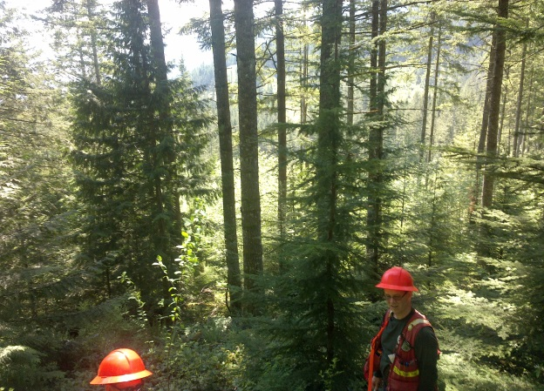
SEDRSS Application Fdc
Moderate retention ( 10 - 16 m2 per ha)
Resource values moderately constrain
post harvest stand structure
SEDRSS applies
Fdc secondary species for regeneration
(marginally ecologically suitable)
Moderate retention (16-40 m2 per ha)
Resource values moderately constrain
post harvest stand structure
SEDRSS applies
Fd not ecologically suitable for regeneration
Coast Region FRPA Implementation Team
Notes:
Moderate retention
Retention is long term usually left as a combination of dispersed and aggregates often with patchy non uniform distribution. Focus for retention trees should be on those needed to achieve the non timber resource vales(e.g., visually sensitive areas, cultural areas, sensitive terrain, wildlife management objectives etc)
Fdc considered marginally ecologically suitable for regeneration in areas with between 10 and 16 m2 per ha (maximum 200 well spaced or Free growing sph). (Generally not suitable on N aspects unless no residual trees within 2 tree lengths)
Cw also considered marginally ecologically suitable with retention levels > 10 m2 per ha (maximum 200 well spaced or free growing stems per ha)
Fdc plus a combination of more shade tolerant species (dependent upon BEC and site series) will need to be managed for in the regeneration layer
Retention of trees in a dispersed pattern will have a greater negative effect on Fdc regeneration growth than retention in an aggregate pattern
Consideration shape, size and spatial orientation of aggregate retention patches to maximize the contribution of Fdc in the regeneration layer
Higher levels of retention often result in higher levels of Hw natural ingress, which has a competitive advantage over Fdc in the lower light regeneration environment
dispersed retention > 16 m2 per ha
will result in a species shift in the regeneration layer with more shade tolerant species being managed for. Cw considered only marginally ecologically suitable in second growth Fd stands with retention levels between 10 and 23 m2 per ha
Expect productivity loss and perhaps value loss when regenerating more shade tolerant species
Future value maintained by leaving a component of good and fair quality residuals representative of the species profile.

Slide 8
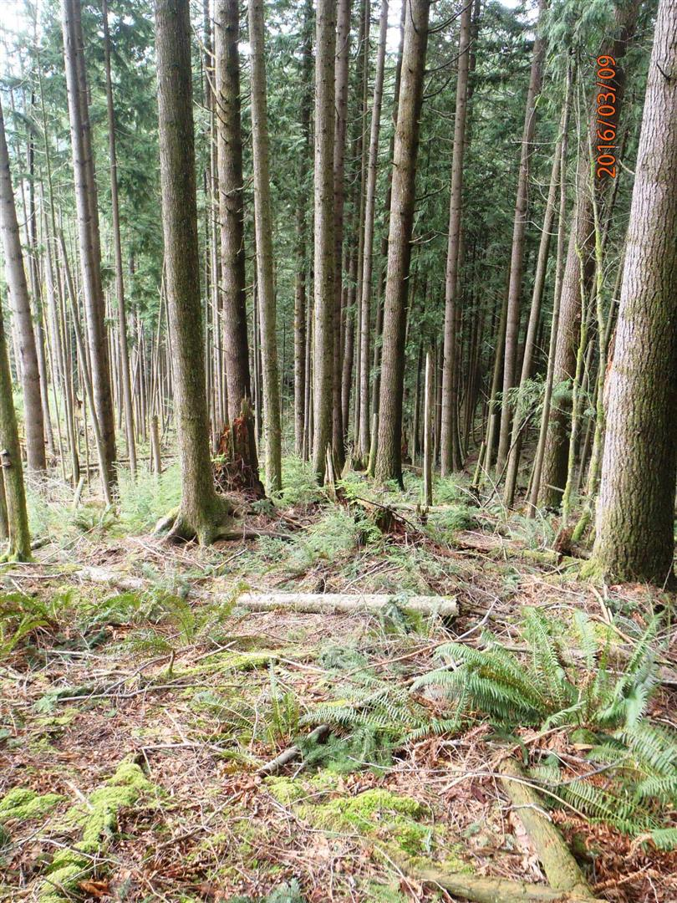
SEDRSS Application - Fdc
High retention (> 40 m2 per ha)
Resource objectives do not allow for
much flexibility in post harvest stand
Structure.
SEDRSS does not apply.
e.g., Intermediate cutting ,
commercial thinning
Coast Region FRPA Implementation Team
Notes:
High retention harvesting such as intermediate cutting or commercial thinning is exempt from a free growing obligation. There is no expectation for regeneration from this practice, (i.e., there is reasonable site occupancy remaining post harvest). The CRIT SWG defined this site occupancy of being > 40m2 RBA per ha with reasonable distribution (limited or no openings > 0.1ha)
Often applied in areas with adjacency constraints where the requirements outlined in FPPR s 65 (2) and (3) have not been met, or areas with very restrictive VQOs (e.g. Preservation)
these areas are exempt from free growing obligations as per FPPR 44 (3) (h) and (i)

Slide 9
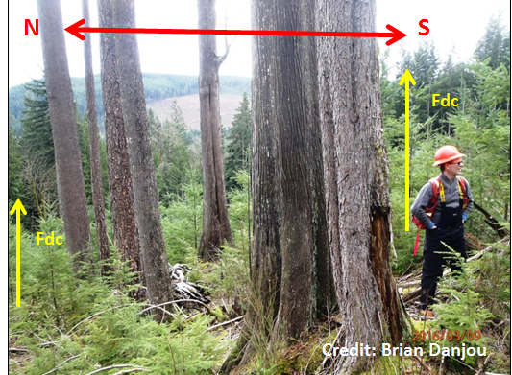
SEDRSS Application - Fdc
  SEDRSS-Fdc may apply to aggregate
  retention if:
  > 15 % of the Su occupied by
  internal aggregates or
  > 15 m2/ha mean basal area
  over entire Su
Coast Region FRPA Implementation Team
Notes:
If one of the these two criteria apply then a SEDRSS standard is more appropriate than an even-aged standard
Even aged stocking standards may be appropriate for second growth Fd stands with aggregate retention if:
Retention patches > 2 tree lengths apart, < 20 meters wide and < 150 metes long
Retention patches are orientated north south
Retention patches are between 0.1 and 0.25 ha in size and targeted towards the external boundary rather than isolated within the internal boundaries
Picture highlights the relative difference in Fdc height growth associated with a North or south aspect adjacent to retention

Slide 10
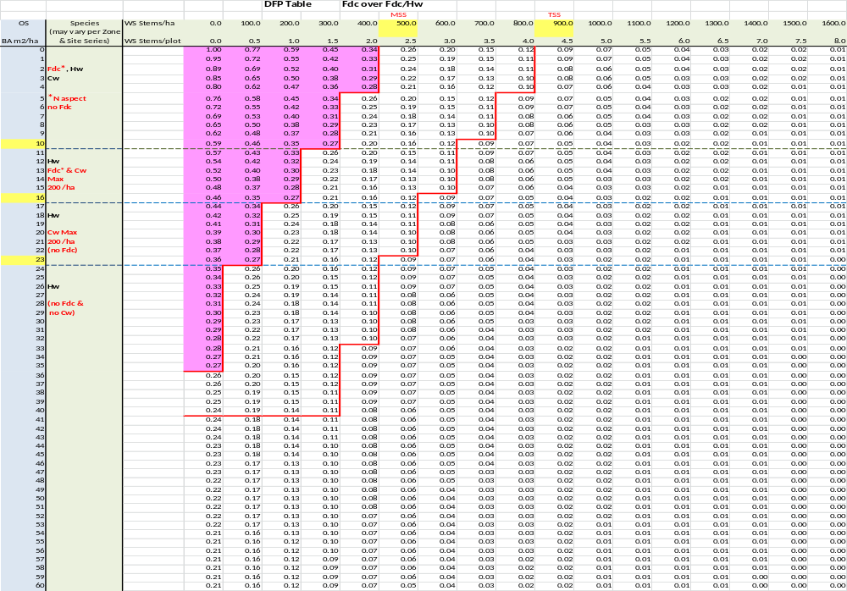
SEDRSS – Fdc
DFP table (Smith 2014)
Coast Region FRPA Implementation Team
Notes:
DFP recognizes two components an overstorey (> 12.5 cm dbh) and an understorey (< 12.5 cm dbh)
DFP focuses on the future yield from the understorey.
TASS was used to relate future yield to understorey density. A Fdc overstory was modeled with a Fdc/Cw/Hw understory
Without a residual overstorey, as understorey density increases, future yield increases rapidly and then levels off.
With increased overstorey retention, understorey yield decreases
DFP ranges from a value of 0 to a value of 1. A DFP of 0 indicates the stand is fully stocked (i.e., no additional space to add stocking). A DFP value of 1 indicates there is no stocking and there 100 % deviation from potential
DFP table shows that the relative break points where Fdc growth is reduced. At levels of dispersed retention > 16 m2 Fd reliability of a crop tree is in question and Fdc is not considered suitable for regeneration. The more shade tolerant Hw regeneration ingress begins to significantly compete with planted Fdc at levels of dispersed retention > 10 m2 per ha

Slide 11
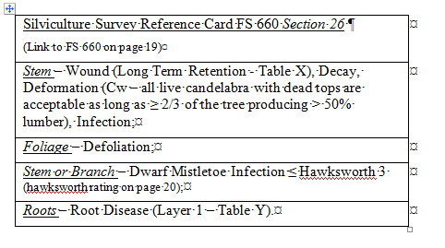
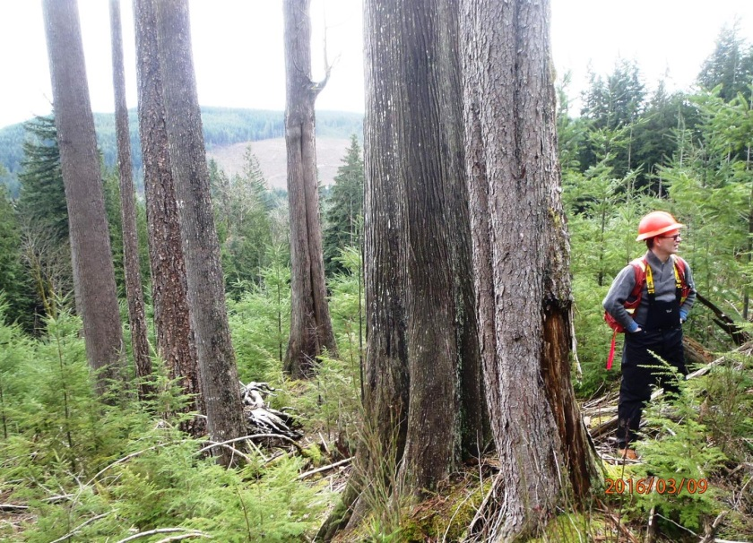
Overstorey trees
Key points:
Crop tree:
A tree with acceptable timber value and of acceptable health and vigour
Tree must meet or exceed damage criteria as indicated on survey reference card for multi-storied damage criteria
Coast Region FRPA Implementation Team
Notes:
For second growth stands an overstory crop should have a minimum 30 % continuous live crown

Slide 12
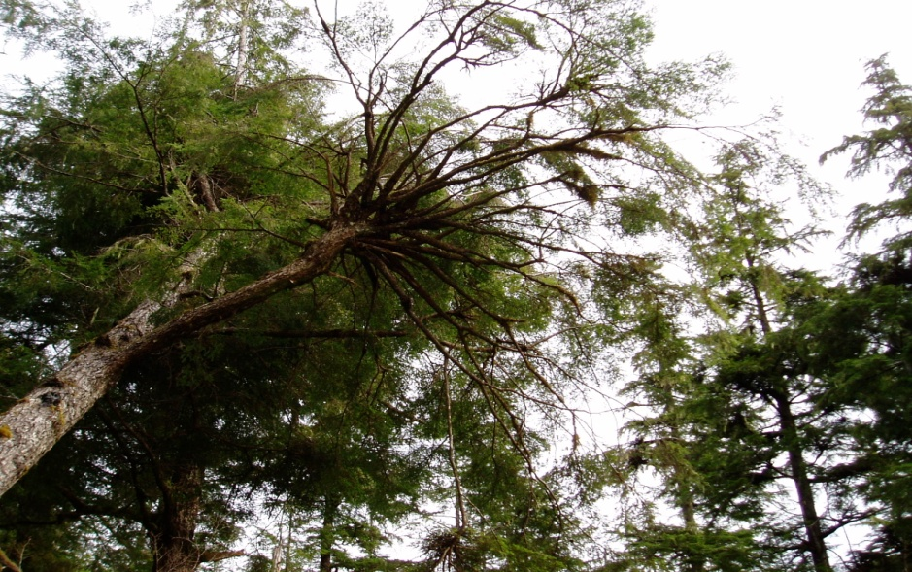
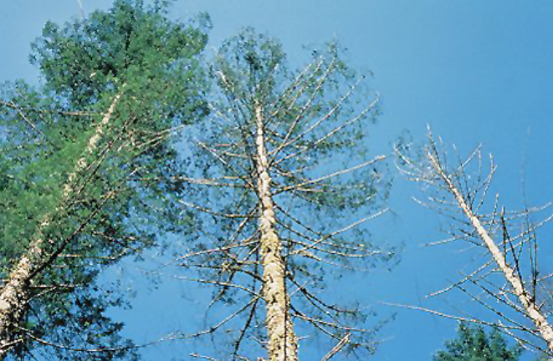
Overstorey trees
Key points:
Non Crop tree:
Trees that do not meet the criteria as a crop tree or are considered non commercial trees.
e.g., a tree that does not meet the forest health criteria such as hemlock dwarf mistletoe, root disease, scarring
Coast Region FRPA Implementation Team

Slide 13
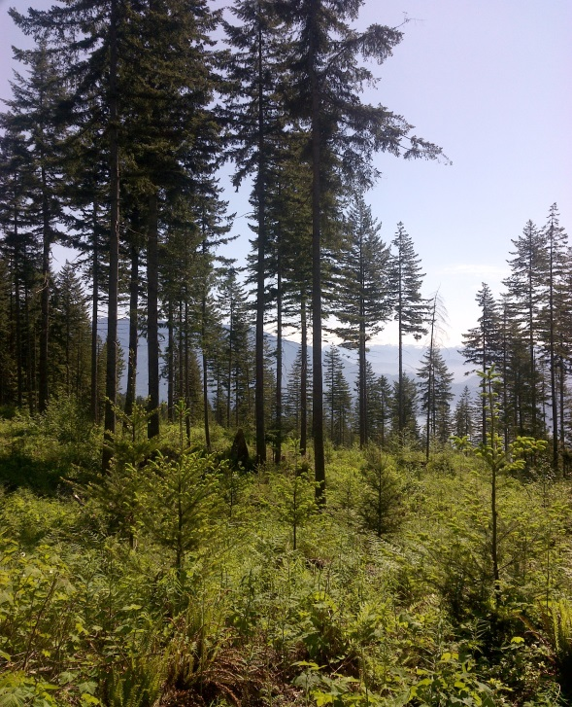
Regeneration
Key points:
Trees < 12.5 cm dbh
Meet the advanced regeneration criteria
Outside the dripline¹ of an overstorey tree
≥ the identified minimum height
contain an upright leader
¹ “the vertical boundary of the outside of the outer live foliage of the overstorey tree”. An understory tree is considered outside the Dripline if “the main stem pith of the understorey stem is outside of the Dripline as defined above”.
Coast Region FRPA Implementation Team
Notes:
Criteria for regeneration are found in section 21 of FS660 (silviculture survey reference card)
The Dripline is defined as “the vertical boundary of the outside of the outer live foliage of the overstorey tree”. An understory tree is considered outside the D
Dripline if “the main stem pith of the understorey stem is outside of the Dripline as defined above”.
A Fdc bacterial cancer has been observed on understory Fdc branches and stems at a partial harvest research trial near Roberts Creek on the sunshine coast. The damage from this bacteria is similar to gall rust. This bacteria has been incorporated into the Fg damage criteria for SEDRSS

Slide 14
SEDRSS Alternative Approaches
1) Deviation from Potential (DFP) approach
Integrates the retained overstorey using residual basal area with regeneration using deviation from potential
2) DFP Tabular interpretation approach
Integrates the retained overstorey and the regeneration using the DFP concepts, but presents them in a tabular format similar to even-aged standards
Coast Region FRPA Implementation Team
Notes:
The SEDRSS stocking standard discussion paper describes two approaches for presenting of stocking standards.

Slide 15
Fdc DFP stocking obligation criteria
Stocking table | Situation and Circumstance e.g., CWH dm 01 SI₅₀< 30 m For use in visual corridors with a VQO of PR
Average DFP | ≤ 0.26
Proportion of plots in “open” class is: (shaded pink on DFP table) | ≤ 25%
RBA between the prescribed levels: | 4 to 40 m²/ha or
Coast Region FRPA Implementation Team
Notes:
This table shows and example standard using the DFP approach.
Stocking decision: To achieve the standard all the conditions in the table must be met.
The average DFP for all plots is 0.26 or less, the proportion of plots found within the open class is met, and the residual basal area is between the prescribed amounts.
The stocking decision accounts for variability by limiting the proportion of the plots that are not stocked.

Slide 16
Example SEDRSS – Fd
Tabular approach
 |  | Regeneration Guide |  |  |  |  |  |  |  |  | Free Growing Guide
 |  | Species | Site Occupancy |  |  |  |  |  | Regen Delay (max yrs) | MITD
BGCU | Layer |  | All BA combinations are applicable to survey plots |  |  |  |  |  |  |  | Species | Height (m)
 |  |  | Only used during plots | One of these 4 BA combinations are applicable to final SU REGEN / FG SEDRSS obligations |  |  |  | Only used during plots
CWH dm Site series 01 | Residual Layer (L1) (≥12.5dbh) (BA m² /ha) | Fdc, Cw, Hw | 0-4 m² /ha | 5-10 m² /ha | 11-16 m² /ha | 17-23 m² /ha | 24-39 m² /ha | ≥ 40 m² /ha | 3 | N/A | N/A
 | Regen Layer (L2-L4) (WS / ha. TSS – Target MSS - Minimum) | Fdc¹ Cw², Hw | 900 TSS 500 MSS | 800 TSS 400 MSS | 700 TSS 300 MSS | 500 TSS 200 MSS | 400 TSS 100 MSS | 0 0 | 3 | L1 Drip line or 2.0 m (L2-L4) | Fdc Hw Cw |  | 3.0 3.0 1.5
1 Fd ecologically suitable where < 10 m2 per ha . Restricted to max 200 sph where retention > 10 m2 per and < 16 m2 per ha
2 Cw ecologically suitable where <10 m2 per ha. Restricted to max 200 sph where retention > 10 m2 per and < 23 m2 per ha
Coast Region FRPA Implementation Team
Notes:
This approach integrates the overstorey and understorey aspects of the DFP and presents them in a tabular format
The DFP table is consolidated by grouping basal area and understory density into a table. The regeneration layer stocking corresponds to the residual basal area category.
The tabular format is designed to match as closely as possible the current stocking standard tables for even-aged standards as referenced in the Reference Guide to FDP stocking standards.
Target and minimum occupancy and unimpeded well spaced are identified for each basal area grouping.
The primary difference in using this approach vs. the DFP approach is the concept of an M value for basal area and for target unimpeded well spaced. Max basal area is capped at 40 m2. Target regeneration is capped at the target relative to the basal area component
Stocking Decision
The SU is found to have met its Regen Obligation or Free Growing Obligation if:
the mean Regen or FG sph ≥ the MSS sph
for the corresponding Average Crop BA from the table
Note: The ecological acceptability decision around Fd and Cw occurs at the plot level (i.e., if there is > 16 m2 retention, based on a prism sweep, in an individual plot Fdc regeneration would not be counted as a crop tree in the plot. If there is between 10 and 16 m2 retention in a plot then only 1 Fdc can be counted as a crop tree in the 50 m2 regeneration plot. That well spaced Fdc crop tree would need to be outside the dripline of any overstory residual whether crop tree or not)

Slide 17
Common Issues associated with SEDRSS stocking standard submissions
Lack of clarity around the scope of application of SEDRSS
(i.e., situations and circumstances)
Lack of consistent terminology
(e.g., mixing of terminology like % RBA vs actual RBA)
Lack of clarity around leave tree criteria for residual trees
(addressing short and long term forest health risks)
Ecological acceptability of some trees species in the regeneration layer (e.g., consideration for shade tolerance)
Coast Region FRPA Implementation Team
Notes:
Given that application of partial harvest is generally not assumed as a management assumption in TSR it is important that where and when it will be applied is clearly stated within the FSP. This is important as partial harvest will have an affect on timber yield. It is also important to ensure the DDM has enough information to evaluate the FPPR section 26 approval tests
There is often a mixing of terminology (e.g., using percent pre-harvest basal area rather than actual basal area)
As the layer 1 trees occupy growing space and will hopefully contribute to future timber supply it is important to define what an acceptable leave trees is (helps to address the FPPR 26 (3) immediate and long term forest health tests). The stocking standard needs to be clear as to what is an acceptable tree both for the mature layer as well as the regeneration layers
Given high levels of retention certain shade intolerant species may not be ecologically acceptable in areas of high retention. We should not assume that all species identified by BEC site series in even aged clear-cut standards will be ecologically acceptable in the regeneration layer of a SEDRSS standard.

Slide 18
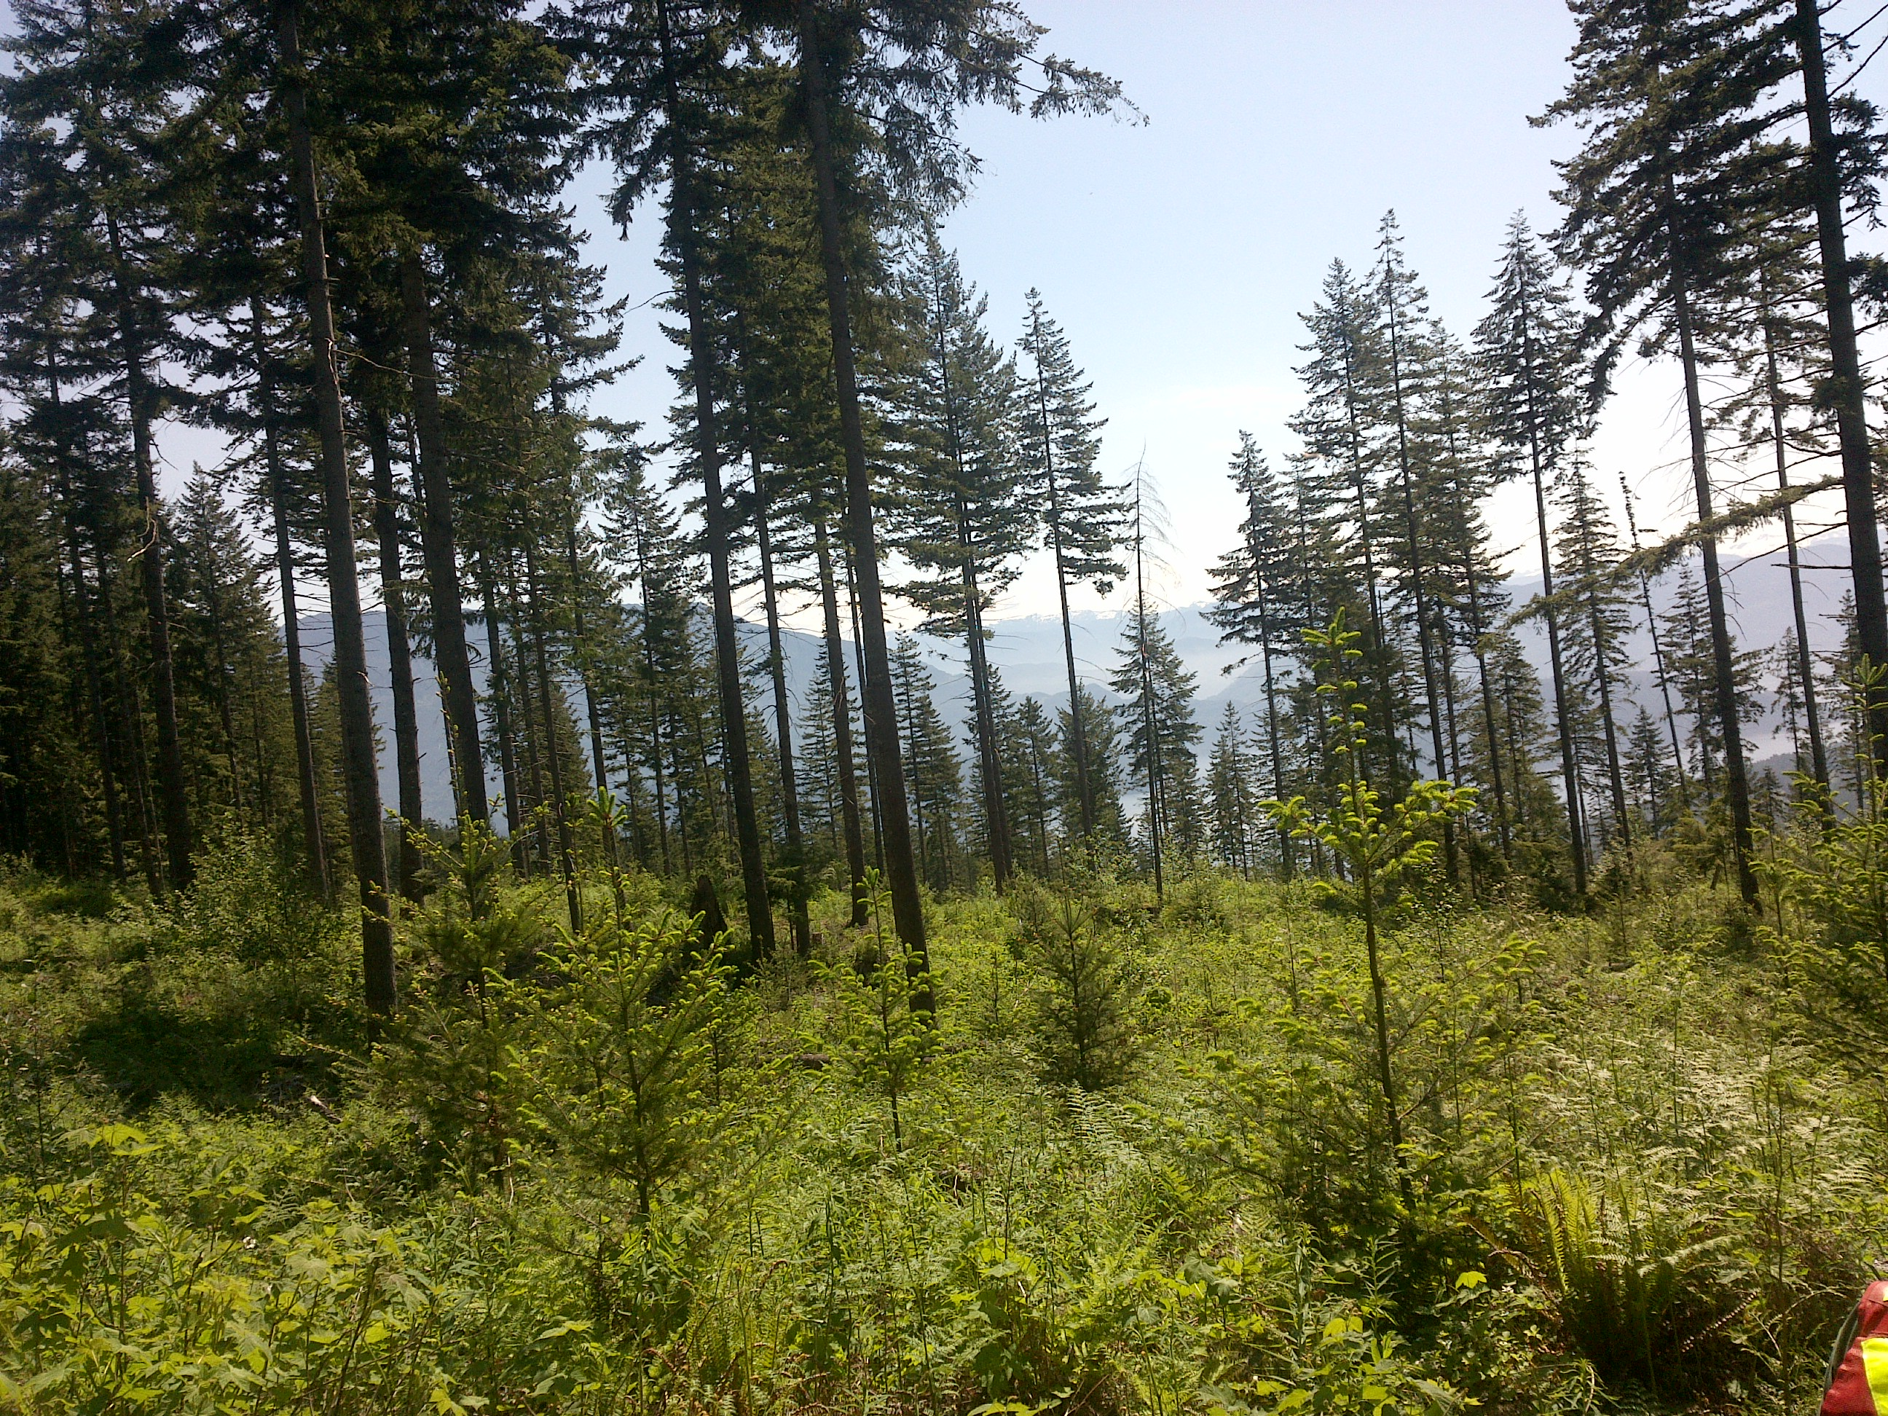
SEDRSS Fdc
Questions ?
Coast Region FRPA Implementation Team

